Slide 1
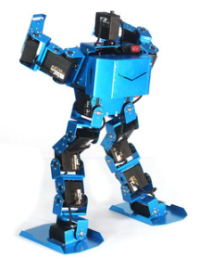
Biped Robot
Fahad
Mohammed
Naif
Sponsor: Program FEES

Slide 2
Introduction
The is a Design project to make a robot which provides a sufficient way to Balancing Robot
An Autonomous Robot with the Wheels to balance on rough and tough terrains
With the help of wheels, it can move in all the directions on different terrains to show the balancing.
Control the Robot through the instructions uploaded in its system
Project Sponsored by: PROGRAM FEES

Slide 3
Design Description
3D CAD MODEL Has developed

Slide 4
Bill of Material
Bill of Materials
Team
# | Part Name |  | Qty | Description | Functions | Material | Dimensions | Cost | Link to Cost estimate
1 | Servo Motor |  | 6 | To do the movement in each direction | Do the walking, dancing, balancing | Steel | 1.2 x 1 in | $82.74 | Ebay
2 | Steel Sheet |  | 4 | Cut the sheet to make the robot sides | Form the structure of robot | Steel | 100 x 100 mm | $38.32 | Ebay
3 | Arduino |  | 1 | Control the Robot motors | Pass the signals to each part | Silicon | 4 in x 4 in | $3.49 | Ebay
4 | Controller |  | 1 | Control the robot wirelessly | Connect with Arduino to pass signals | Plastic | 6 x 4 in | $27.99 | Ebay
5 | Blue Smurft Bluetooth |  | 1 | Connect control with Arduino | Make the connection with Controller | Silicon | 4 in x 4 in | $27.99 | Spark Fun
6 | Strap Hinges |  | 12 | Make conneciton with motor and Plates | Put on the joints | Steel | 2 in x 4 in | $26.28 | Ebay
7 | High gloss Tape |  | 1 | To hold the items on the board | Grip all the parts over the robot | Vinyl PVC | 4 x 2 in | $139.49 | Ebay
8 | Screws |  | 50 | Make the connections | Hold the joints with hinges | Steel | 0.5 x 0.1 in | $1.14 | Ebay
9 | Battery |  | 2 | Provide power to arduino and motors | Generate the electricity from storage | Li-Ion | 4 x 2 in | $97.50 | Ebay

Slide 5
Bill of Materials
Bill of Materials
Team
# | Part Name |  | Qty |  | Description | Functions | Material | Dimensions | Cost | Link to Cost estimate
10 | Battery Cells | 4 | Controller power | Provide power to the controller | Li-Ion | 3 x 1 in | $11.96 | Ebay
11 | Jumper Wires | 4 | Connect between the parts | Make all the connection for supply | Copper | 6 x 0.1 in | $4.00 | Ebay
12 | Power Adopter | 1 | To charge the battery | Provide the charging to the robot battery | Plastic | 4 x 2 in | $14.59 | Ebay
Total | $475.49
Total incl. tax | $556.32

Slide 6
Design Functions
Wheeler Robot
Balancing
Move Forward
Move Backward
Stable in all directions
Increase and decrease the speed

Slide 7
Design Requirements
Customer Requirements
Wheeler Robot
Reciprocal Linear Mechanism
Forward and Backward Motion
Safe to Use
Remotely Control
Long battery backup
Smooth Transition
Racing speed can control
Capable of Balancing in all directions
Perform dancing
Reliable
Long lasting Durable

Slide 8
Design Requirements
The Robot Design is Wheeler Design so the first requirement has fulfilled
Reciprocal Linear Mechanism requirement has fulfilled using the motors that directly operate the wheels with the help of a gear system
Forward and Backward motion requirement has fulfilled as the robot can move forward and backward with the help of wheels
The Robot is safe to use because no sharp edge is present so the requirement has fulfilled
Remotely Control the Robot requirement: Autonomous robot but the instructions will pass to the Robot using the remote so remote control access

Slide 9
Design Requirements
Long Battery Backup: Use of high power battery for long battery backup
A Smooth transition is fulfilling because of wheels using in it and also the smooth transition can be seen
Racing Speed can control as the speed of forwarding and backward motion can control so this requirement is fulfilling
Balancing in all directions using the gyroscope so fulfilled this requirement by the design
Perform Dancing: This requirement has not yet decided to fulfill or not

Slide 10
DESIGN Requirements
Reliable: As the design is strong and motors will use good quality to make it reliable so this requirement is fulfilled.
Long-Lasting or Durable: Steel will use to develop the outer body that will be long-lasting so this requirement was fulfilled.
Almost all the requirements have fulfilled by the design only the dancing capability has not decided yet and also dancing is not an important aspect for the balancing rob

Slide 11

Design Requirements
Dimensions
$H=20 cm$
$W=6 cm$
$Area=W ∗H$
$Area=20 ∗6$
$Area=120 cm^{2}$
Hence the required area is also $120cm^{2}$ so this requirement has fulfilled as well

Slide 12
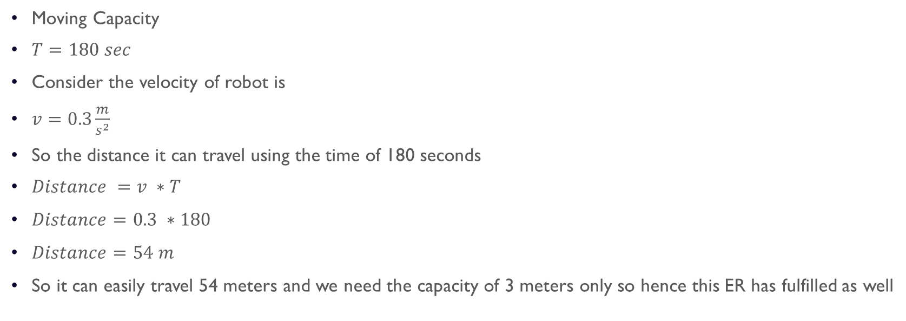
Design Requirements
Moving Capacity
$T=180 sec$
Consider the velocity of robot is
$v=0.3\frac{m}{s^{2}}$
So the distance it can travel using the time of 180 seconds
$Distance =v ∗T$
$Distance=0.3 ∗180$
$Distance=54 m$
So it can easily travel 54 meters and we need the capacity of 3 meters only so hence this ER has fulfilled as well

Slide 13
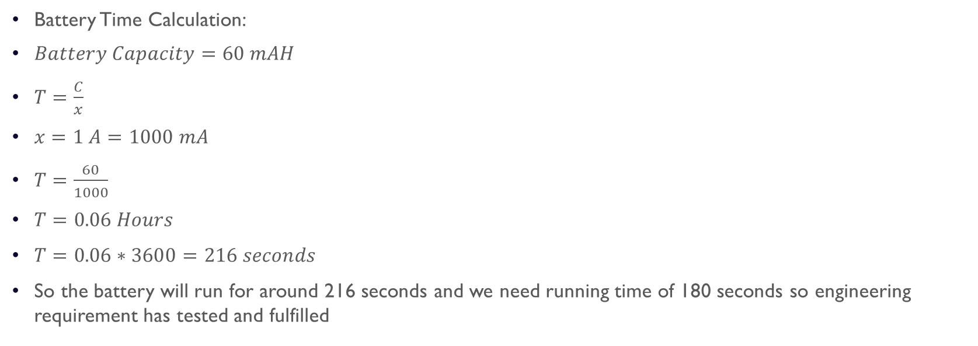
Design Requirements
Battery Time Calculation:
$Battery Capacity=60 mAH$
$T=\frac{C}{x}$
$x=1 A=1000 mA$
$T=\frac{60}{1000}$
$T=0.06 Hours$
$T=0.06∗3600=216 seconds$
So the battery will run for around 216 seconds and we need running time of 180 seconds so engineering requirement has tested and fulfilled

Slide 14

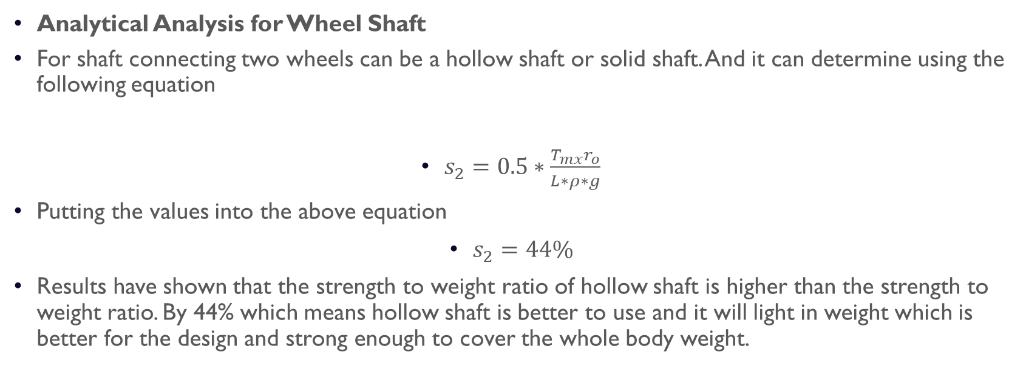
Design Requirements
Analytical Analysis for Wheel Shaft
For shaft connecting two wheels can be a hollow shaft or solid shaft. And it can determine using the following equation
$s_{2}=0.5∗\frac{T_{mx}r_{o}}{L∗ρ∗g}$
Putting the values into the above equation
$s_{2}=44\%$
Results have shown that the strength to weight ratio of hollow shaft is higher than the strength to weight ratio. By 44% which means hollow shaft is better to use and it will light in weight which is better for the design and strong enough to cover the whole body weight.
$s_{2}=0.5∗\frac{T_{mx}r_{o}}{L∗ρ∗g}$

Slide 15
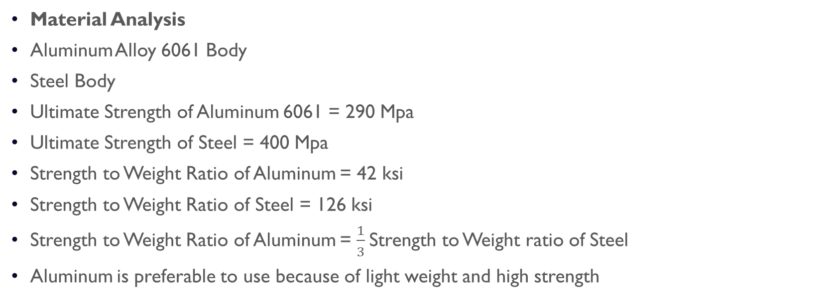
Design Requirements
Material Analysis
Aluminum Alloy 6061 Body
Steel Body
Ultimate Strength of Aluminum 6061 = 290 Mpa
Ultimate Strength of Steel = 400 Mpa
Strength to Weight Ratio of Aluminum = 42 ksi
Strength to Weight Ratio of Steel = 126 ksi
Strength to Weight Ratio of Aluminum = $\frac{1}{3}$Strength to Weight ratio of Steel
Aluminum is preferable to use because of light weight and high strength

Slide 16
FMEA ANALYSIS
Part # and Functions | Potential Failure Mode | Potential Effect(s) of Failure | Severity (S) | Potential Causes and Mechanisms of Failure | Occurrence (O) | Current Design Controls Test | Detection (D) | RPN | Recommended Action
1.1 Aluminum Sheet | steering and net tension | Joint Leakage | 5 | 1. opposite force to the joint | 3 | Putting load on the joint | 2 | 30 | Strong Connect
1.2 Aluminum sheets | Tensions and breakage | cracks on the sheet, destruction of sheet | 6 | Extra load on sheet, No support for the sheet | 4 | Checking the stress on the sheet | 3 | 72 | None
2.1 screw | Breakage of screw, Destruction of the screw cap | Unable to un screw it, unable to screw properly Half | 8 | 1. Low quality manufacturing 2. Non use of proper tools | 1 | 1. Stress testing for screw 2. Use of various quality tools | 2 | 16 | None
3.1 screw gun | Extra speed of gun, burning of motor | Unbale to screw the boards, Extra costs, wastage of time and resources | 3 | 1. Over heating 2. Improper voltage 3. over use | 2 | 1. Testing with various types of screws 2. voltage change test | 3 | 18 | None
3.2 Motor | Burning of motor, dislocation of wings angle | purpose of device failed, extra cost addition | 6 | 1. bad quality of copper 2. poor windings 3. over voltage, over speed | 4 | 1. Speed test 2. Over voltage test | 8 | 192 | Check multiple fans and test them roguishly
4.1 Shaft | Bending of Shaft, Breakage of Shaft | wait for new shaft, cost increased | 7 | 1.Bad quality due to molding, 2. poor quality shaft is used | 4 | 1.Bad seeding, Poor Quality aluminum | 6 | 168 | Test various qualities if pipes available at same cost

Slide 17
FMEA Analysis
Part # and Functions | Potential Failure Mode | Potential Effect(s) of Failure | Severity (S) | Potential Causes and Mechanisms of Failure | Occurrence (O) | Current Design Controls Test | Detection (D) | RPN | Recommended Action
3.11 chargeable batteries | Overcharging, no charging, discharge too quick | usefulness will be lost, power will be wasted, less back of power | 4 | 1. No power backup will be available 2. wind energy will be wasted | 6 | 1. Testing with various types charging screws up will be available 2. will change test | 2 | 48 | try to place charging circuit
5.1 rubber Wheels | breaking of rubber start, bending, changing shape due to temperature | start will not work, changing the rubber will be extra costly | 6 | 1. start will not work | 4 | 1. rubber stress test | 7 | 168 | None
5.2 Silicon board | silicon breaking, strand weakness | moisture will increase and short-circuit may occur | 3 | 1. Robot will loose control | 3 | 1. Structure extreme weather conditions tests | 5 | 45 | None
6.1 Wheel Rims | angle changes, breakage, changing load on turbine | Robot will not able to move and cause extra cot | 9 | Wheels will not move in a line | 8 | 1. Efficiency lost | 8 | 576 | Test in extreme conditions and loads

Slide 18
DESIGN VALIDATION
Risk Trade-Off Analysis
Risk Trade-Off analysis has shown that we need to trade with the weight to get the maximum result from the Robot
Weight is a critical part of the design but increasing a little bit of more weight can gain can us much more efficiency and accuracy. •From the analysis
Increase of weight by 2 lb. can provide the speed up to 5 m/s^2
So an increase of 40% in the weight can get around 800% increase in speed because of adding extra powerful motor which can support the rotation and provided high torque.

Slide 19
Testing Procedures
Dimensions
The Area can test using the foot scale
Multiply the width and height to get the area
Battery Time
Battery time can test by running the battery with the motors with full load and use the time clock to record the total battery time
Walking Length Capacity
The Capacity of moving for the robot can test by measuring the distance using the meter scale
Height
Height will test using the foot scale.

Slide 20
Testing Procedures
Wheel Radius
The radius of the wheel can also test using the foot scale.
Degree of Freedom
It will test by counting the motors and then check with the naked eyes how many motors are using DOF
Width
It will also test using the foot scale

Slide 21
Budget
Budget
Total Budget | $1500
Estimated Budget | $556
Prototype Cost | $450
Contingency Budget | $344
Travelling etc. | $150

Slide 22
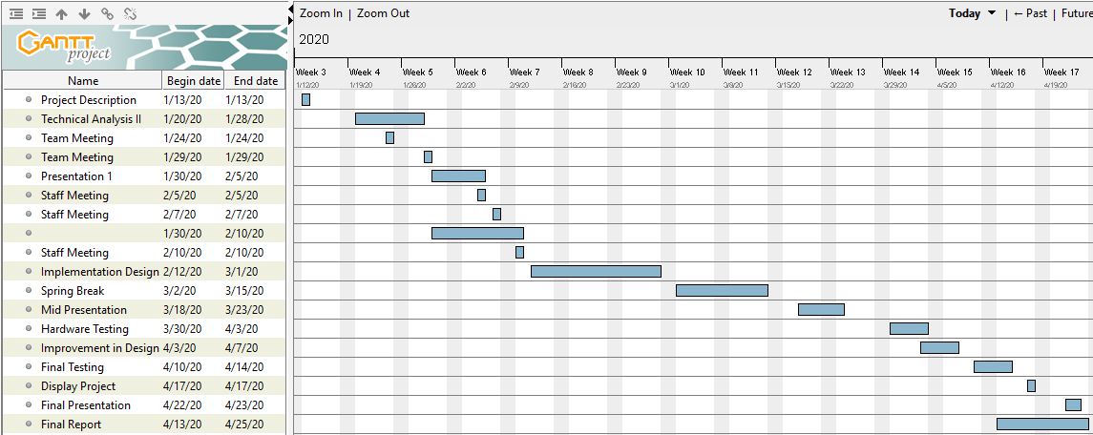
SCHEDULE – Gantt Chart

Slide 23
Reference
[1] https://www.ebay.com/itm/360-20KG-Waterproof-High-Torque-Metal-Gear-RC-Servo-Motor-Car-Helicopter-Boat/
[2] https://www.ebay.com/itm/STAINLESS-STEEL-SHEET-PLATE-in-Various-sizes-and-Thickness/112740090156?var=413195179173&hash=item1a3fd5412c:m:mPUwwyOw159DWFCKTJz7fqA
[3] https://www.ebay.com/itm/Arduino-UNO-R3-Mini-Micro-USB-ATmega328P-CH340G-Replace-ATmega16U2-Board/20192795
[4] https://www.ebay.com/itm/PS4-DUALSHOCK-4-Wireless-Controller-Bluetooth4-0-Gamepad-for-SONY-PlayStation-US/123895207849?hash=item1cd8bad7a9:m:mL4D1NtKRZ7718d31_Ts2fg
[5] https://www.sparkfun.com/products/12577
[6] https://www.ebay.com/itm/Strong-Heavy-Duty-Strap-Hinges-Zinc-Tee-Door-Gate-GOLD-Choose-your-pack-size/142432290165?hash=item2129a04575:m:mRej1rysKMpJj9NQ2h7a8MA
[7] https://www.ebay.com/itm/Multicolor-Adhesive-High-Gloss-Film-Vinyl-PVC-Tape-Automotive-Grade-Car-Wrap/223034541877?var=521843692188&hash=item33ede50735:g:6qEAAOSwi5dcl0Qt
[8] https://www.ebay.com/itm/M3-Black-12-9-Grade-Alloy-Steel-Allen-Hex-Socket-Cap-Head-Screw-Bolt-DIN912/182022519670?_trkpar
[9] https://www.ebay.com/itm/4-4Ah-4400mah-36v-18650-lithium-battery-pack-for-Balance-Scooter-Board-2-wheel/123902060267?_trkparms=aid%3D555018%26algo%3DPL.SIM%26ao%3D1%26asc%3D6
[10] https://www.ebay.com/itm/Safest-3-7V-18650-Charger-Lithium-Ion-Battery-USB-Rechargeable-Battery- Universal/153613634183?_trkparms=ispr%3D1&hash=item23c4160a87:m:m_p07jw_b4GxCYAdeRoJrZQ&enc=AQAEAAA
[11] https://www.ebay.com/itm/10-20-30CM-Jumper-Wire-Cable-Male-to-Male-to-Female-to-Female-Arduino-Breadboard/392315907400?_
[12] https://www.ebay.com/itm/AC110-220V-Power-Supply-Adapter-Transformer-LED-Strip-2A-3A-5A-8A-DC-5V-12V-24V/322286626497?_trkparms=ispr%3D1&hash=item4b09c7a6c1:m:mQ3El- m3_vZFy4IcfeV7aTg&enc=AQAEAAACMBPx

Slide 24
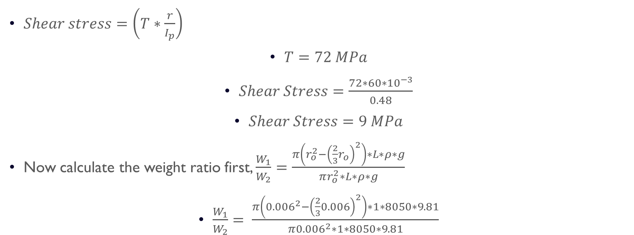
APPENDIX A – Shaft Calculations
$Shear stress=\left(T∗\frac{r}{I_{p}}\right)$
$T=72 MPa$
$Shear Stress=\frac{72∗60∗{10}^{−3}}{0.48}$
$Shear Stress=9 MPa$
Now calculate the weight ratio first, $\frac{W_{1}}{W_{2}}=\frac{π\left(r_{o}^{2}−{\left(\frac{2}{3}r_{o}\right)}^{2}\right)∗L∗ρ∗g}{πr_{o}^{2}∗L∗ρ∗g}$
$\frac{W_{1}}{W_{2}}= \frac{π\left({0.006}^{2}−{\left(\frac{2}{3}0.006\right)}^{2}\right)∗1∗8050∗9.81}{π{0.006}^{2}∗1∗8050∗9.81}$

Slide 25

APPENDIX A – Shaft calculations
$\frac{W_{1}}{W_{2}}=0.5556$
$s_{1}=τ_{max}\frac{0.4012πr_{o}^{3}}{π∗0.5556∗r_{o}^{2}∗L∗ρ∗g}$
Reducing the above equation yield to
$s_{1}=0.7221∗\frac{T_{mx}r_{o}}{L∗ρ∗g}$
So now put the values into the above equation
$s_{1}=0.7221∗9∗\frac{0.006}{1∗805∗9.81}$
$s_{1}=4.93∗{10}^{−6}$

